Slide 1
Unity 3D and Azure
Simplified approach to storing game data in the cloud

Slide 2
Our Background
Who We Are
Andrew Boudreau – Web Developer @andrewboudreau
Dylan Ryan - Unity Developer
What We Do
C# .NET developers in casual learning space, mlevel.com
Targeting Enterprise Customers (woe is me)
Need to support a variety of black-box authentication mechanisms
We can’t use Game Center or Google’s Play

Slide 3
Tools & Technologies
A completely free solution
Targeting C# developers
Server solution
Azure Websites
Web Services using ASP.NET WebApi 2.0
Data Persistence using Entity Framework 6 & Azure SQL free edition (20mb)
Security using Microsoft Identity for Authorization
Client solution
Unity 3D

Slide 4
The Plan & Takeaways
A functional example disguised as a leaderboard
https://github.com/mLevel/Leaderboard
Build, Package, Publish
A quick development walkthrough
Gotchas of these tools
Questions ?

Slide 5
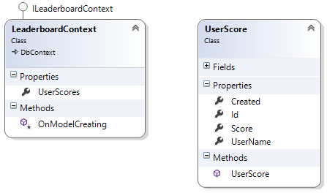
Data Transfer Diagram

